Slide 1
Get Your Hands Dirty with Intel® Distribution for Python to accelerate Data Analytics and Machine Learning
Zhang Zhang, Victoriya Fedotova
Intel Corporation
November 2016

Slide 2
Agenda
Introduction
A quick intro to Intel Data Analytics Acceleration Library and Intel Distribution for Python
A brief overview of basic machine learning concepts
Lab activities
Warm-up exercises: Learn the gist of PyDAAL API
Linear regression
Classification with SVM
K-Means clustering
PCA
Conclusions

Slide 3

Intel® data analytics acceleration library

Slide 4
Data Analytics Flow Example Spam Filter
Pre-process
Collect
Store
Load
Train & Validate
Deploy
Make Decision
Modelling
Notes:
Pre-processing:
Feature selection on the device (word frequency)
Reduce data transfer
Reduce storage requirements
Effective loading the data from the DB

Slide 5

Computational Aspects of Big Data
Distributed Computing
Online Computing
Volume
Distributed across different nodes/devices
Huge data size not fitting into node/device memory
Variety
Non-homogeneous data
Sparse/Missing/Noisy data
Velocity
Data coming in time
R₁
D₁
R
D_{k}
D₃
D₂
D₁
S_{i},R_{i}
R_{k}
R = F(R₁,…,R_{k})
S_{i+1} = T(S_{i},D_{i}); R_{i+1} = F(S_{i+1})
Converts, Indexing, Repacking
Data Recovery
1
F
F
F
F
1
D
D
D
D
Kernel D Dense
D
D
D
D
1
F
F
F
F
F
F
F
F
2
D
D
D
D
2
D
D
D
D
D
D
D
D
2
D
D
D
D
D
D
D
D
3
B
B
B
B
4
D
D
D
D
3
B
B
B
B
Recover
B
B
B
B
4
I
I
I
I
7
D
D
D
D
Kernel C
Indexed
D
D
D
D
4
I
I
I
I
I
I
I
I
5
C
C
C
C
D
D
D
D
5
C
C
C
C
C
C
C
C
6
C
C
C
C
6
C
C
C
C
C
C
C
C
7
F
F
F
F
Counter
I
7
F
F
F
F
F
F
F
F
8
C
C
C
C
8
C
C
C
C
C
C
C
C
Histogram
I
I
I
I
Notes:
Big Data Attributes and Computational Solution
Distributed across different nodes/devices
Distributed computing, e.g. comm-avoiding algorithms
Huge data size not fitting into node/device memory
Distributed computing
Online algorithms
Non-homogeneous data
Categorical→Numeric (counters, histograms, etc)
Homogeneous numeric data kernels
Conversions, Indexing, Repacking
Sparse/Missing/Noisy data
Sparse data algorithms
Recovery methods (bootstrapping, outlier correction)
Data coming in time
Data buffering
Online algorithms

Slide 6


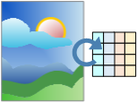


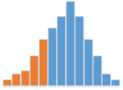
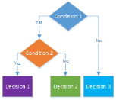
Intel® Data Analytics Acceleration Library (Intel ® DAAL)
Targets both data centers (Intel® Xeon® and Intel® Xeon Phi™) and edge-devices (Intel® Atom)
Perform analysis close to data source (sensor/client/server) to optimize response latency, decrease network bandwidth utilization, and maximize security
Offload data to server/cluster for complex and large-scale analytics
Scientific/Engineering
Pre-processing
Transformation
Analysis
Modeling
Validation
Decision Making
Web/Social
Business
Regression
Linear
Ridge
Classification
Naïve Bayes
SVM
Classifier boosting
kNN
Clustering
Kmeans
EM GMM
Collaborative filtering
ALS
Neural Networks
(De-)Compression
(De-)Serialization
PCA
Statistical moments
Quantiles
Variance matrix
QR, SVD, Cholesky
Apriori
Outlier detection

Slide 7
Intel DAAL Main Features
Building end-to-end data applications
Optimized for Intel architectures, from Intel® Atom™, Intel® Core™, Intel® Xeon®, to Intel® Xeon Phi™
A rich set of widely applicable algorithms for data mining and machine learning
Data connectors to a variety of data sources and formats: KDB*, MySQL*, HDFS, CSV, and user-defined sources/formats
Batch, online, and distributed processing
C++, Java, and Python APIs

Slide 8

Intel® distribution for python
INTEL® HPC DEVELOPER CONFERENCE Fuel Your Insight
http://www.rarewallpapers.com/animals/blue-snake-2029/

Slide 9
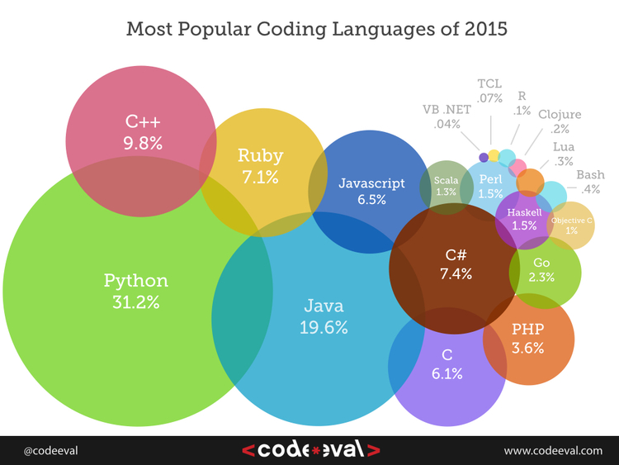
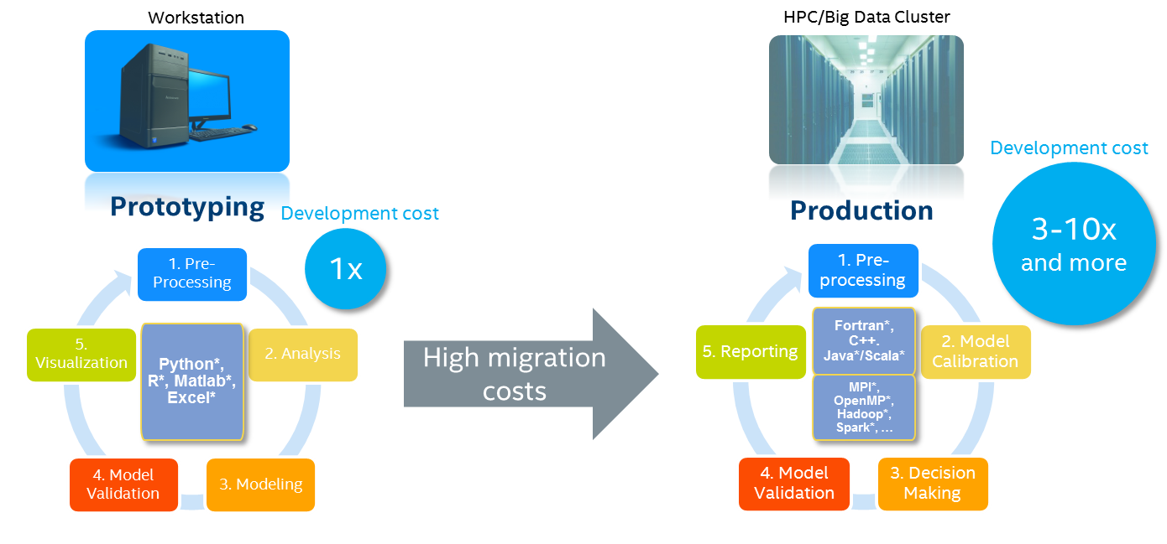
Python Landscape
Adoption of Python continues to grow among domain specialists and developers for its productivity benefits
Challenge#1:
Domain specialists are not professional
software programmers.
Intel’s solution is to…
Accelerate Python performance
Enable easy access
Empower the community
Challenge#2:
Python performance limits migration
to production systems
Notes:
Reducing performance gap between Python and Native code requires programming skills.
Python limitations
Runs slower than C, C++, Fortran for CPU-intensive workloads.
GIL – prevents efficient execution of multithreaded applications
Building python packages with dependencies needs some level of expertise

Slide 10
Highlights: Intel® Distribution for Python* 2017 Focus on advancing Python performance closer to native speeds
Easy, out-of-the-box access to high performance Python
Prebuilt, accelerated Distribution for numerical & scientific computing, data analytics, HPC. Optimized for IA
Drive performance with multiple optimization techniques
Accelerated NumPy/SciPy/scikit-learn with Intel® Math Kernel Library
Faster access to latest optimizations for Intel architecture
Distribution and individual optimized packages available through conda and Anaconda Cloud
Optimizations upstreamed back to main Python trunk
Drop in replacement for your existing Python. No code changes required
Data analytics with pyDAAL, Enhanced thread scheduling with TBB, Jupyter* notebook interface, Numba, Cython
Scale easily with optimized mpi4py and Jupyter notebooks
Notes:
The Intel® Distribution for Python focuses on techniques and solutions to accelerate the performance of Python, and bundle these optimizations in a Distribution that is easily accessible to the beginner Python user to the most experienced developer. This is out-of-the-box access to high performance Python optimized for IA! As a user, you don’t have to do any code changes or worry about dependencies management, which is quite a challenge with Python. Just download, install and use as a drop-in replacement for your existing Python.
These optimizations will be of great interest to you if you are working with Python for numerical & scientific computing, data analytics, HPC and machine learning. Our goal is to bring near native performance to Python, to bridge the current gap of using Python as predominantly a prototyping environment, to robust production level high performance application deployments.
We leverage the powerful Intel® Math Kernel Library to accelerate functions in NumPy/SciPy/scikit-learn, leading to almost a 100X speedup for select functions like DGEMM. You can easily access the made-for-data analytics “Intel® Data Analytics acceleration Library” through the pyDAAL package. Eke out further performance from your applications through efficient thread scheduling with TBB. Also included are Numba for high performance functions written in Python, and Cython for easily writing C extensions.
You can scale to distributed systems using the mpi4py and Intel® MPI library. The inclusion of Jupyter notebooks interface makes it easy to create, share and deploy your applications on the web or across clusters.
Through the Intel® Distribution for Python, you get fastest access to the latest performance optimizations for the latest Intel architecture. Intel works closely with the Python community and upstreams contributions to the main trunk. This process for integration however takes time to be integrated and broadly available. Intel also collaborates closely with other ecosystem partners like Continuum Analytics, in order to make these advancements and performance accelerations available to the entire Python community, in an effort to raise the general baseline performance of Python.
Multiple techniques for high performance – One solution to bring it all together! Intel® Distribution for Python.

Slide 11
Performance Gain from MKL (Compare to “vanilla” SciPy)
Linear Algebra
BLAS
Fast Fourier Transforms
Multidimensional
Vector Math
Trigonometric
LAPACK
ScaLAPACK
Sparse BLAS
Sparse Solvers
FFTW interfaces
Cluster FFT
Hyperbolic
Exponential
Log
Power, Root
Up to 100x faster
Up to 10x faster!
Up to 10x faster!
Vector RNGs
Multiple BRNG
Summary Statistics
Kurtosis
And More
Splines
Support methods for independent streams creation
Support all key probability distributions
Order statistics
Min/max
Variance-covariance
Variation coefficient
Interpolation
Trust Region
Fast Poisson Solver
Up to 60x faster!
Configuration info: - Versions: Intel® Distribution for Python 2017 Beta, icc 15.0; Hardware: Intel® Xeon® CPU E5-2698 v3 @ 2.30GHz (2 sockets, 16 cores each, HT=OFF), 64 GB of RAM, 8 DIMMS of 8GB@2133MHz; Operating System: Ubuntu 14.04 LTS.

Slide 12
PyDAAL (Python API for Intel® DAAL)
Turbocharged machine learning tool for Python developers
Interoperability and composability with the SciPy ecosystem:
Work directly with NumPy ndarrays
Faster than scikit-learn
We’ll see how to use it in this lab

Slide 13
Overview of basic machine learning concepts
INTEL® HPC DEVELOPER CONFERENCE Fuel Your Insight

Slide 14
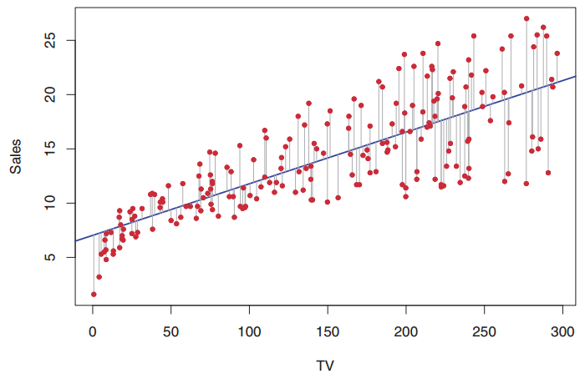
Regression
Problems
A company wants to define the impact of the pricing changes on the number of product sales
A biologist wants to define the relationships between body size, shape, anatomy and behavior of the organism
Solution: Linear Regression
A linear model for relationship between features and the response
Source: Gareth James, Daniela Witten, Trevor Hastie, Robert Tibshirani. (2014). An Introduction to Statistical Learning. Springer

Slide 15
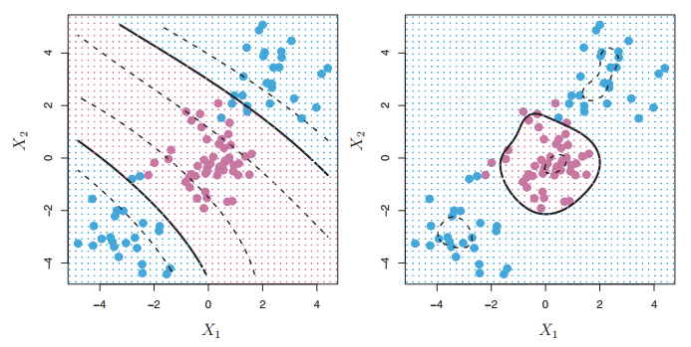
Classification
Problems
An emailing service provider wants to build a spam filter for the customers
A postal service wants to implement handwritten address interpretation
Solution: Support Vector Machine (SVM)
Works well for non-linear decision boundary
Two kernel functions are provided:
Linear kernel
Gaussian kernel (RBF)
Multi-class classifier
One-vs-One
Source: Gareth James, Daniela Witten, Trevor Hastie, Robert Tibshirani. (2014). An Introduction to Statistical Learning. Springer

Slide 16
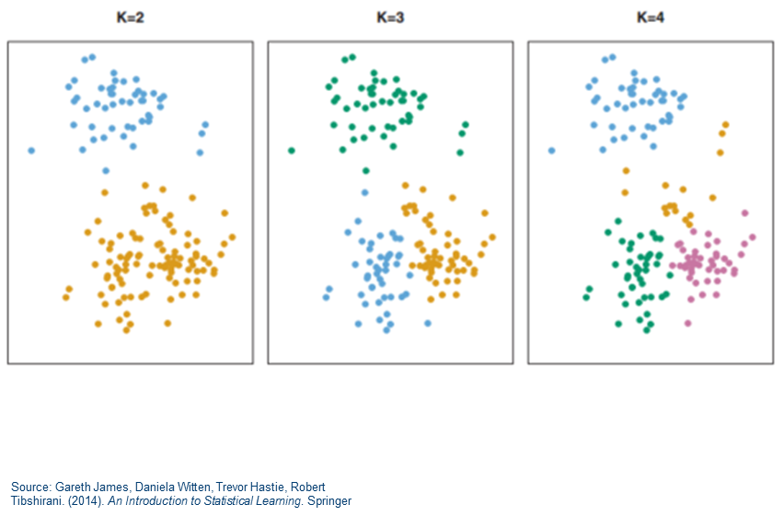
Cluster Analysis
Problems
A news provider wants to group the news with similar headlines in the same section
Humans with similar genetic pattern are grouped together to identify correlation with a specific disease
Solution: K-Means
Pick k centroids
Repeat until converge:
Assign data points to the closest centroid
Re-calculate centroids as the mean of all points in the current cluster
Re-assign data points to the closest centroid
Notes:
Can be used to:
See natural grouping in data
Identify outliers
Preprocess data before supervised learning

Slide 17
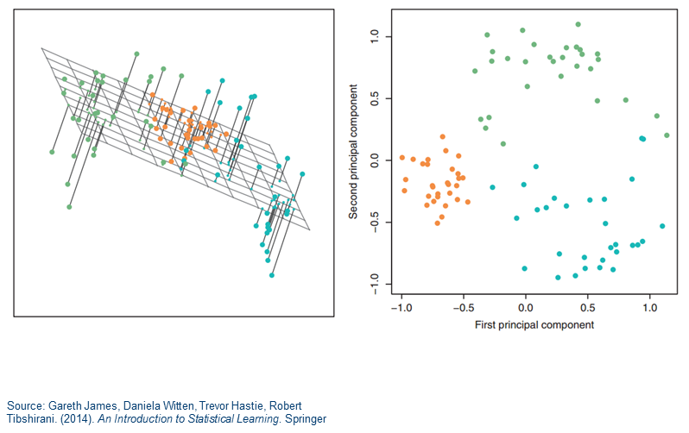
Dimensionality Reduction
Problems
Data scientist wants to visualize a multi-dimensional data set
A classifier built on the whole data set tends to overfit
Solution: Principal Component Analysis
Compute eigen decomposition on the correlation matrix
Apply the largest eigenvectors to compute the largest principal components that can explain most of variance in original data
Notes:
Can be used to:
Reduce number of variables
to reduce the compute power needed for the further analysis
to reduce the storage needed for the data
Remove noise

Slide 18

Lab Activity

Slide 19
Lab 1: Warm-up Exercise
Learning objectives:
Understand NumericTable - The main data structure of DAAL
Create NumericTable from data sources
Interoperability with NumPy, Pandas, scikit-learn
Get NumPy ndarray from NumericTable
Understand code sequence of using DAAL API
Create an algorithm object
Pass in input data
Set algorithm specific parameters
Compute
Get results

Slide 20
Lab 2: Linear Regression
Learning objectives:
Understand the 2 regression algorithms currently available in DAAL
Linear regression without regularization
Ridge regression
Learn supervised learning workflow
Train a model using known data
Test the model by making predictions on new data
Visualize prediction results

Slide 21
Lab 3: Classification with SVM
Learning objectives:
Understand SVM algorithm usage model
Multi-class classification with SVM
Two-class classification with SVM
Understand quality metrics in classification
Confusion matrix
Metrics computed using the confusion matrix (accuracy, etc.)

Slide 22
Lab 4: Clustering with K-Means
Learning objectives:
Understand the K-Means algorithm supported in DAAL
Learn basic clustering workflow
Initialize cluster centroids
Minimize the goal function
Visualize clusters

Slide 23
Lab 5: Principal Component Analysis
Learning objectives:
Understand PCA algorithms support in DAAL:
Correlation matrix method
SVD method
Evaluate and visualize principal components

Slide 24
References
Intel DAAL User’s Guide and Reference Manual
https://software.intel.com/sites/products/documentation/doclib/daal/daal-user-and-reference-guides/index.htm
Intel Distribution for Python Documentation
https://software.intel.com/en-us/intel-distribution-for-python-support/documentation

Slide 25
What’s Next - Takeaways
Learn more about Intel® DAAL
It supports C++ and Java, too!
We want you to use DAAL in your data projects
Learn more about Intel® Distribution for Python
Beyond machine learning, many more benefits
Keep an eye on the tutorial repository
https://github.com/daaltces/pydaal-tutorials
I’m adding more labs, samples, etc.

Slide 26
Thank you for your time
INTEL® HPC DEVELOPER CONFERENCE Fuel Your Insight
Zhang Zhang (zhang.zhang@intel.com)
Victoriya Fedotova (victoriya.s.fedotova@intel.com)
www.intel.com/hpcdevcon

